Slide 1


Credit Risk Analysis
Team Members:
Ashish, Kunal and Neha

Slide 2
Problem Statement
In this project, we will have to put ourselves in the shoes of a loan issuer and manage credit risk by using the past data and deciding whom to give the loan to in the future. To simplify the problem, customers under 'current' status have been considered as non-defaulters in the dataset.
We have to build a data model to predict the probability of Loan status.
We have been provided with:
Dataset containing both train and test data ( Text File)
Data dictionary ( Excel File)
The data should be divided into train (June 2007 - May 2015) and out-of-time test (June 2015 - Dec 2015) data.
The whole process is known as UNDERWRITING. In Order to prove the statement, we have been provided with following features :
grade
home_ownership
annual_inc
verification_status
Installment
issue_d
loan_status
pymnt_plan
sub_grade
emp_title…, ………..,etc.

Slide 3
Data Dimensions
A text files containing complete loan data for all loans issued by XYZ Corp. through 2007-2015. The data contains the indicator of default, payment information, credit history, etc. Moreover a Data dictionary containing the definition of each variable.
Observations :- 855969
Variables :- 73
Dependent Variable : Default_ind was identified as the dependent variable(a binary variable describing 1 as loan issued and 0 as loan not issued).

Slide 4
Exploratory Data Analysis….

Slide 5
Data Cleaning Steps
Univariate Analysis
Variable Transformation
Missing Value Treatment
Outliers Treatment
Bivariate Analysis
Multicollinearity

Slide 6
Data Preprocessing and Univariate analysis¶
.
Check for Null Values
Replace Null Values with appropriate values
Drop down features that are incomplete and are not too relevant for analysis
Create new features that would help improve prediction
Outlier treatments

Slide 7
Removing some of the unwanted variables
Payment plan: This variable is 99.99% unbalanced, the payment plan for all the observations was same hence we will remove it.
Member ID: The id of the member is removed as it is not going to contribute any meaningful parameters to the machine learning model.
Date Variables: Most of the data variables were not of use as it does not matter when the payment is going to be due, so we drop them except for the issued date according to which we need to split our data.
Account deliquent: Since 99% of the values are 0 , that means everyone wants to repay the loan so this variable should be removed.
Variables containing less than 51%data : ("desc","mths_since_last_delinq","mths_since_last_record","annual_inc_joint","dti_joint", "verification_status_joint","open_acc_6m","open_il_6m","open_il_12m","open_il_24m“) were removed due to lack of data.
A lot of other variables were also removed mainly due to lack of data or inability to contribute to the model

Slide 8
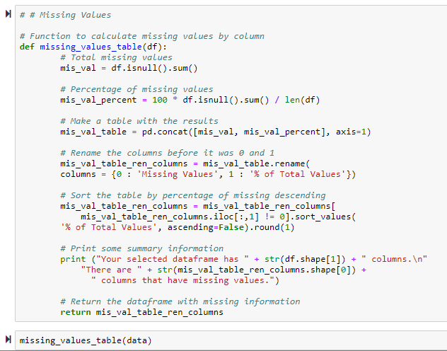
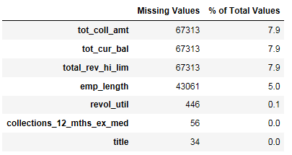
Missing Value Treatment
In this section we will be treating the problem of missing values or NaN values as it may lead to a biased model because we have not analyzed the behavior and relationship with other variables correctly. It can lead to a wrong prediction or classification.
Firstly, we checked the percentage of missing values for each column.

Slide 9
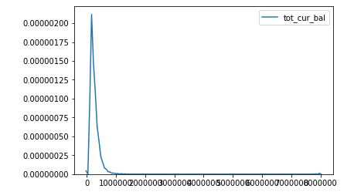
We used the kde plot to identify the distribution of data in a variable and fill in the missing value with the most suitable one.
Some examples of the kde plot are shown below:
This is a plot of total current balance since the data is skewed we would replace the missing values with median.

Slide 10
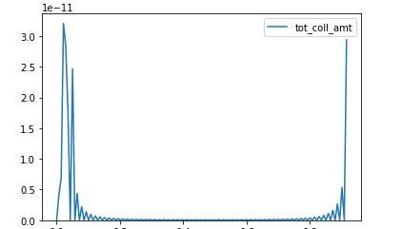
Filling missing values contd..
This is a plot of the total collection amount
We can neither change it with median nor with mean as it has some values at both the ends and moreover, it is not categorical value, hence also not with mode.
Therefore we use backward fill method to fill the nan values.
# df1["tot_coll_amt"].fillna(method="bfill",inplace=True)

Slide 11
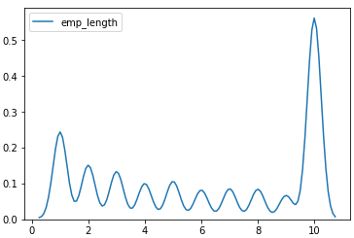
Filling missing values contd..
This is a plot of the employee length or the number of years the candidate has been working .
Since we found out that more than 60% of the candidate has been working for more than 10 years so we replace the nan values with 10 years of employment

Slide 12
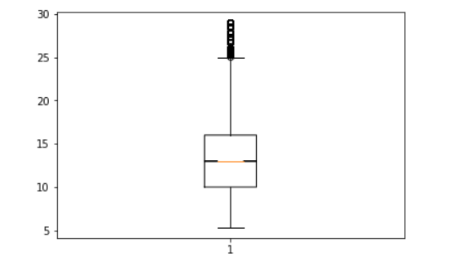
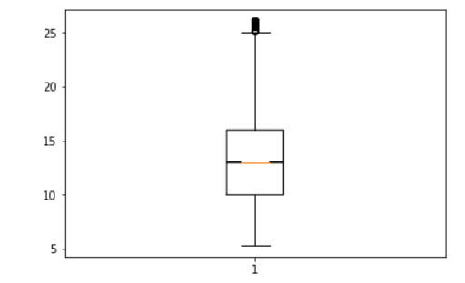
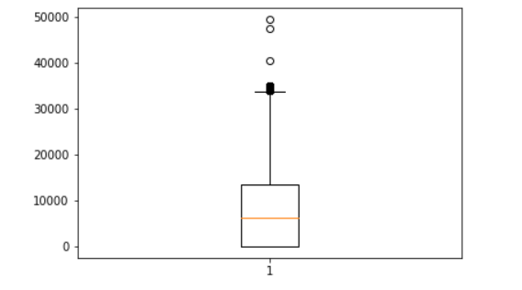
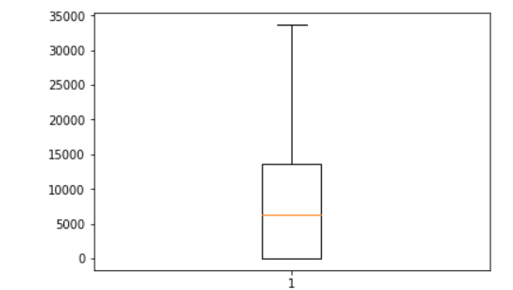
Outlier Treatment
XXXX
In order to check for outliers we used the box plot method.
Here are few variables where we can see the difference in datapoints after outlier Treatment
int_rate
Before
After
out_prncp
Before
After

Slide 13
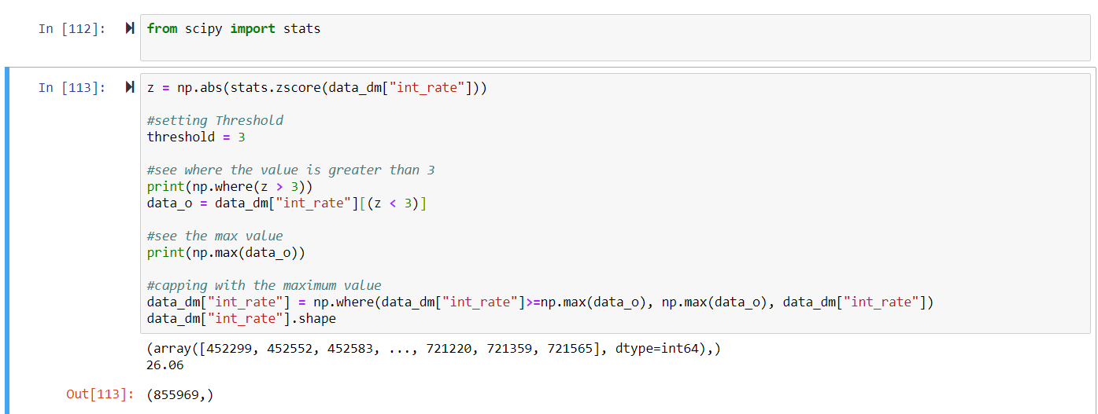
We used the Z score method to fill in the outliers Values having z score grater than 3 were replace by maximum value below z score equal to 3.

Slide 14
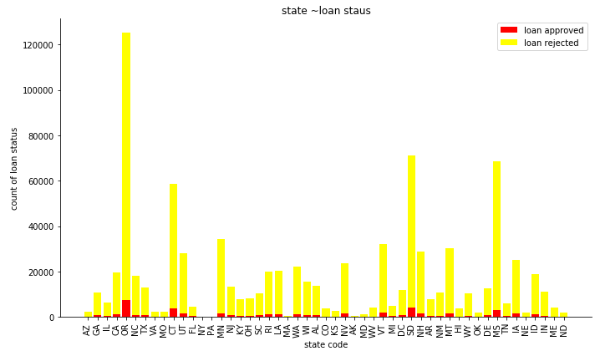
Bivariate Analysis
Analysis:
It is cleared that there is no such big relation which can be get out of this, seems like a balanced situation.¶
how? Since the proportions is almost same in each area code. if 85% - 90% was getting rejected then 15% - 10% were only getting approved for loan in each state

Slide 15
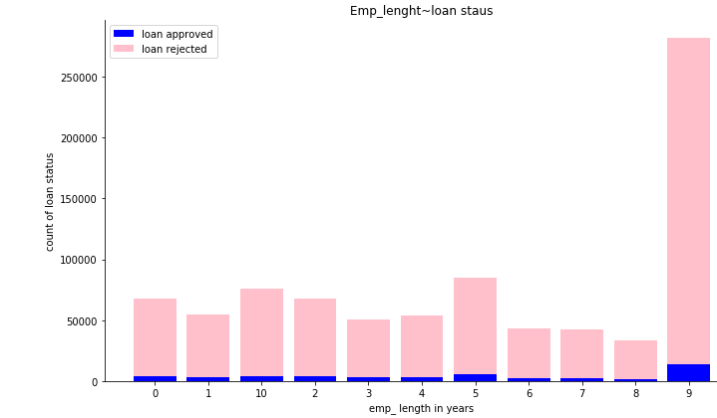
Bivariate Analysis contd..
Analysis :
As the employment length increases, it becomes easy for those employees to get loan.
Comparing the loan approval rate(around 20%) for the emp_length of 8+ years , the Employment length of 4-7 years has low approval rate around(14-15%).

Slide 16
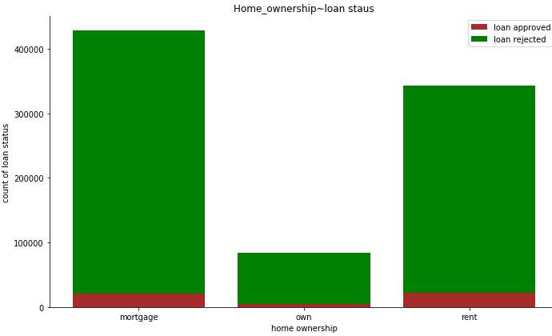
Bivariate Analysis contd..
Analysis :
Proportions are the same for the one who own and mortgage the house but customer who rents the house will have only less chances of getting loan compared to own and mortgage

Slide 17
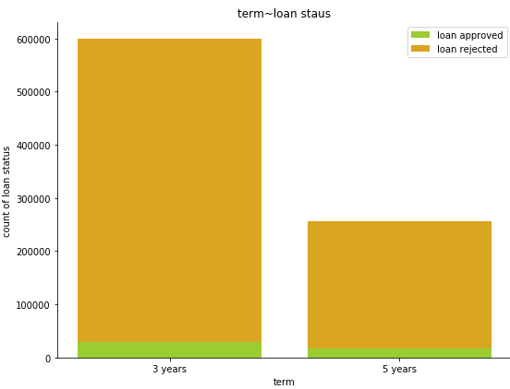
Bivariate Analysis contd..
Analysis :
Loan, which has a term of 3 years, has more chance of getting loan approval, than the loan having term of 5 years.
20% for 3 years term = (3570423/29798)
14% for 5 years term = (239079/16669)

Slide 18
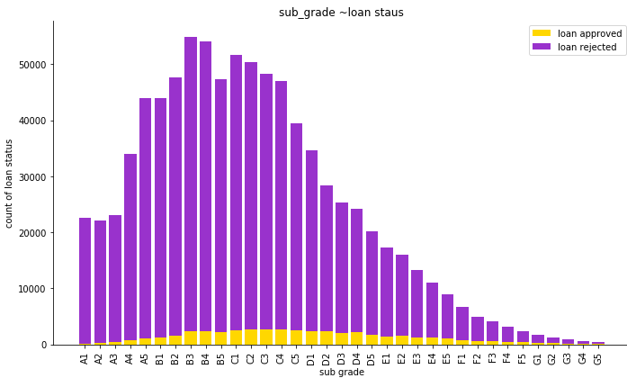
Bivariate Analysis contd..
Analysis:
As the sub grade decreases with respect to its grade the approval gets worse.
But we are removing it for our analysis because grade itself can show collective results and ultimately redundancy can also be avoided.

Slide 19
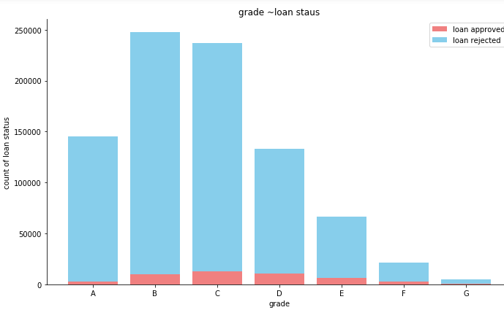
Bivariate Analysis contd..
Analysis:
As the grade decreases, the default rate is also increasing. Grade A has the lowest default rate = 53%(143001/2664)

Slide 20
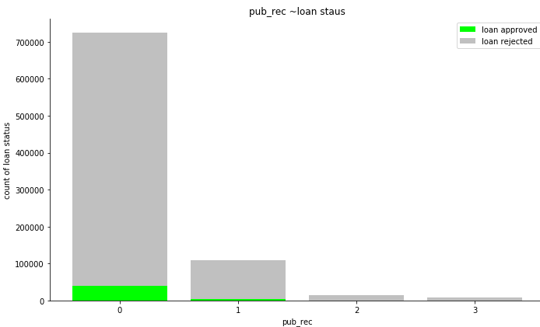
Bivariate Analysis contd..
Analysis:
If the Number of derogatory public records increases, default rate increases.

Slide 21
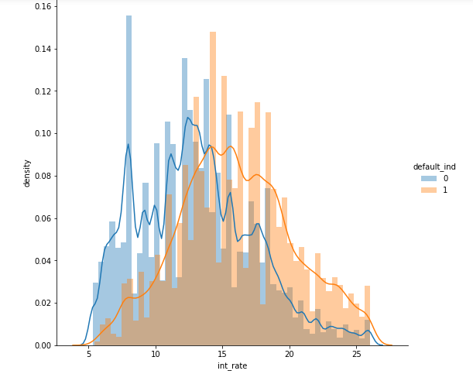
Bivariate Analysis contd..
Analysis:
When the rate was between 5-15 % the the default rate is less, but when it crossed the 15% of interest rate, there is a high chance of default.

Slide 22
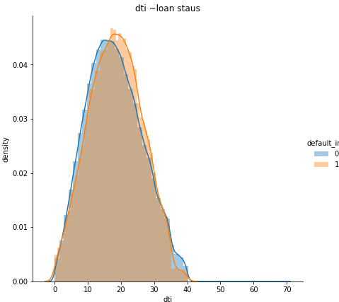
Bivariate Analysis contd..
Analysis:
When the customer's debt income ratio is 0 - 18% = prob of approval rate is marginally less but when the person start taking more loan its approval rate is getting better until it get the 34% mark

Slide 23
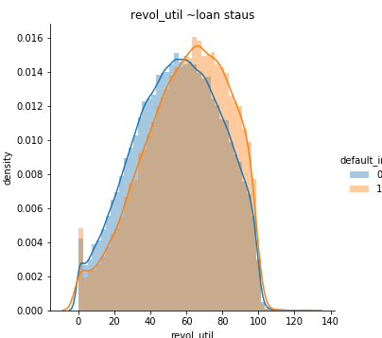
Bivariate Analysis contd..
Analysis:
If the Revolving line utilization rate is between 60-100, probability of getting loan is better.

Slide 24
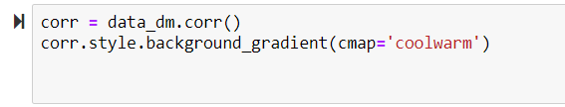
Multicollinearity
In this section we will be treating the problem of Multicollinearity which is caused if two independent variables are corelated to each other . If the degree of correlation between variables is high enough it can cause problem when we fit a model and interpret the results.
Correlation matrix to check Multicollinearity

Slide 25
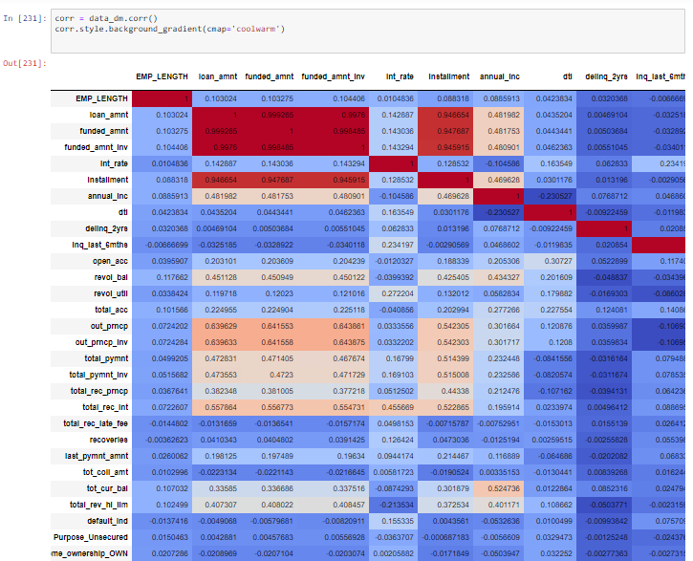
Multicollinearity cont’d..
Output :

Slide 26
Multicollinearity cont’d..
Insights :
loan_amnt, funded_amnt and funded_amnt_inv shares a strong correlation.
Installment is also highly related to loan_amnt, funded_amnt and funded_amnt_inv. But here we will left this to vif to decide which factor should be consider in reponse to another.
out_prncp and out_prncp_inv both are highly correlated with each other.
total_pymnt, total_pymnt_inv and total_rec_prncp all three of them share a strong correlation between them.
recoveries and collection_recovery_fee share a moderate correlation
revol_bal and total_rev_hi_lim also share a moderate correlation

Slide 27
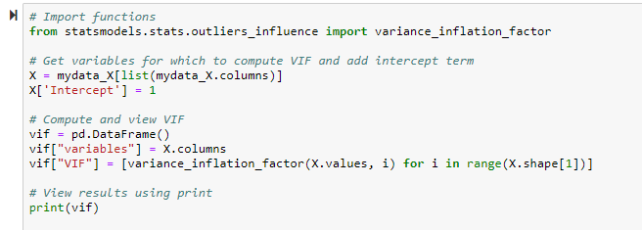
Multicollinearity cont’d..
VIF : VIF stands for Variance inflation factor which helps us identifying the severity of multicollinearity between two independent variables.
We used VIF on our data to identify the variables which needs to be removed because of multicollinearity problem.

Slide 28
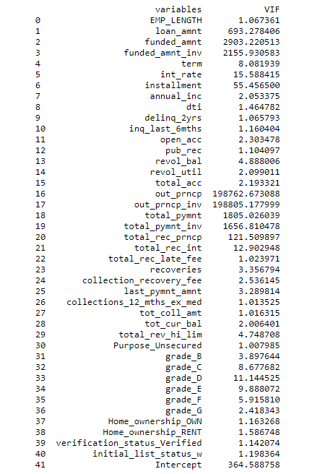
Multicollinearity cont’d..
VIF result :
Variables like
( "funded_amnt_inv",
"loan_amnt", "funded_amnt",
"installment", "out_prncp",
"out_prncp_inv", "total_pymnt_inv",
"total_rec_prncp", "total_pymnt",
"grade_D”)
have given High VIF values and hence we are removing these considering it can cause problem while we fit model.

Slide 29
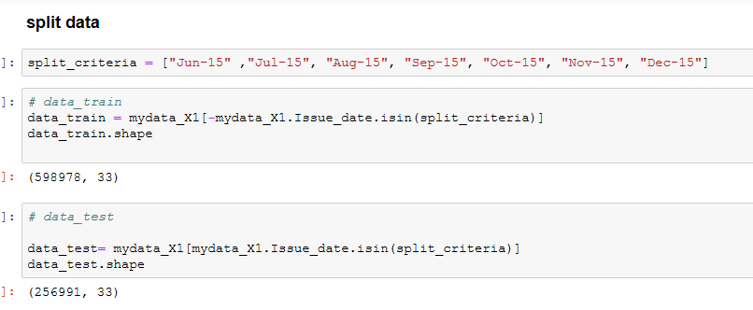
Splitting the data in Training and test sets

Slide 30
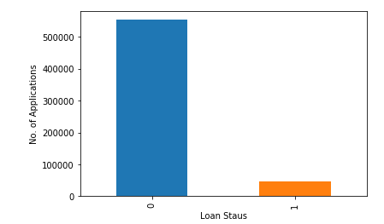
Checking balance between dependent and independent variables
As we can se the data is not balanced we need to balance the data by re sampling.

Slide 31
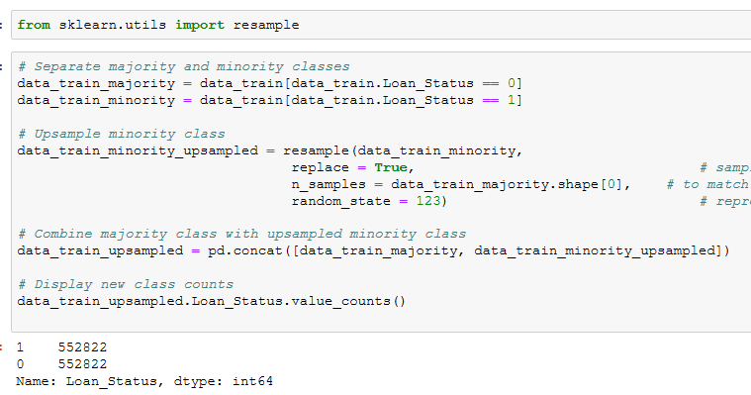
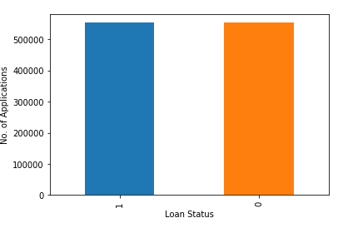
Resampling the data

Slide 32
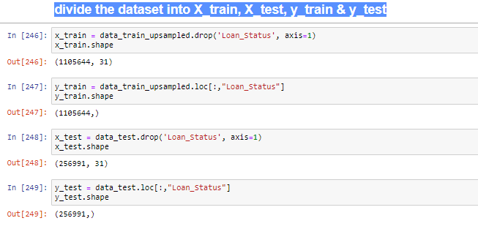
Divide the dataset into X_train, X_test, Y_train & Y_test

Slide 33
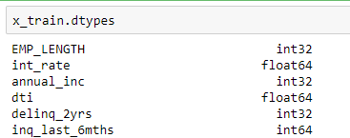
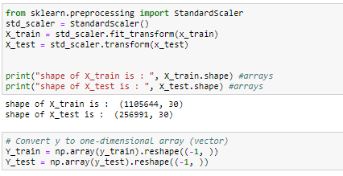
Feature Scaling : Standard Scalar
Before moving to scaling, we must check the data types to see whether there is any object type in data

Slide 34
Models to Evaluate
We will compare five different machine learning Classification models:
1 - Logistic Regression
2 - Decision Tree
3 - Random Forest Classification
4 - Naive Bayes
5- Extreme Gradient boosting Classification

Slide 35
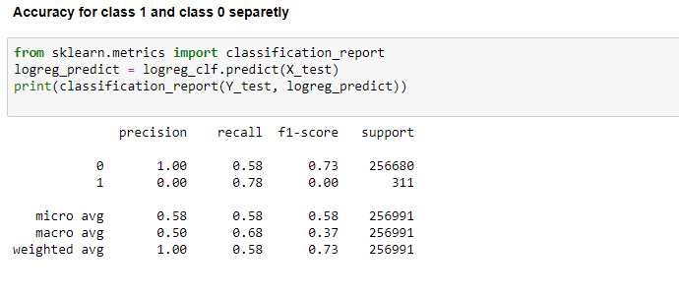
Logistic Regression : Accuracy

Slide 36
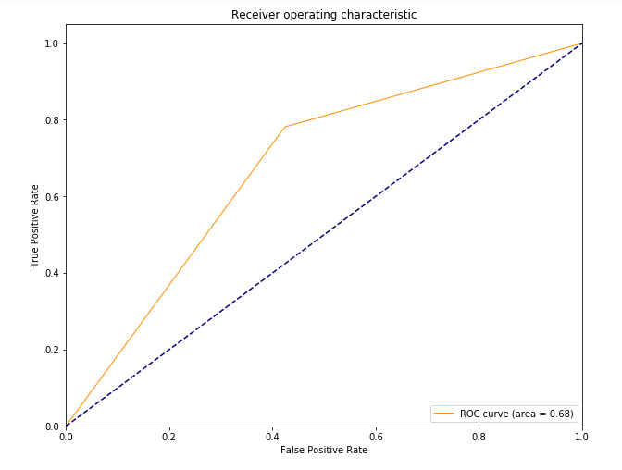
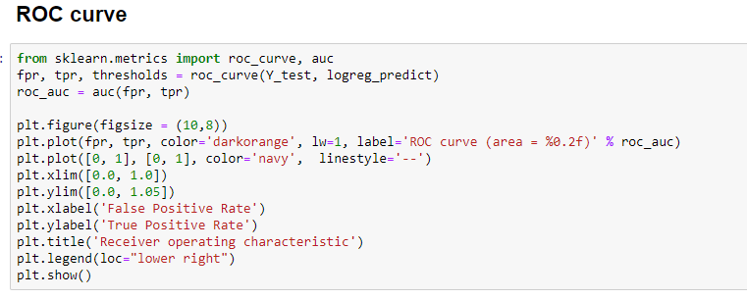
Logistic Regression : ROC Curve

Slide 37
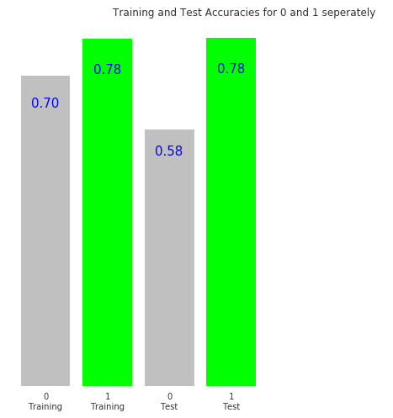
Find the training and testing accuracies by target values
For our model, no matter what’s the total accuracy is, Recall plays a major role in finding that customer who will be coming under the terms of the company provisions of giving loans.

Slide 38
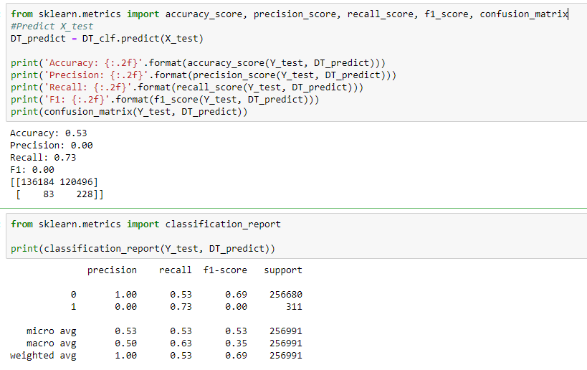
Decision Tree : Accuracy

Slide 39
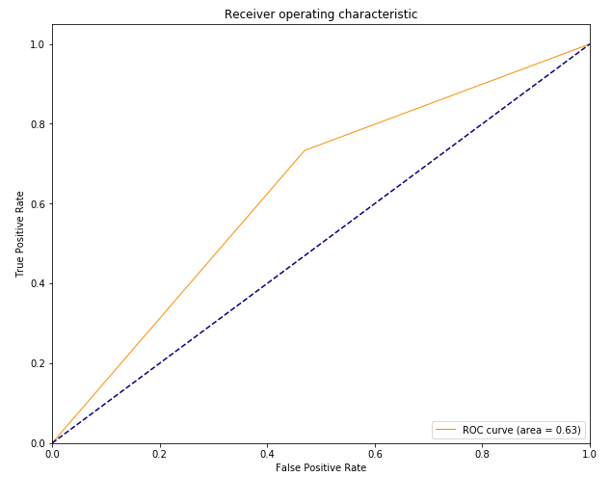
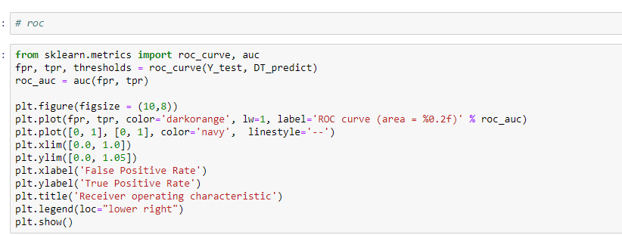
Decision Tree: ROC AREA = 0.63

Slide 40
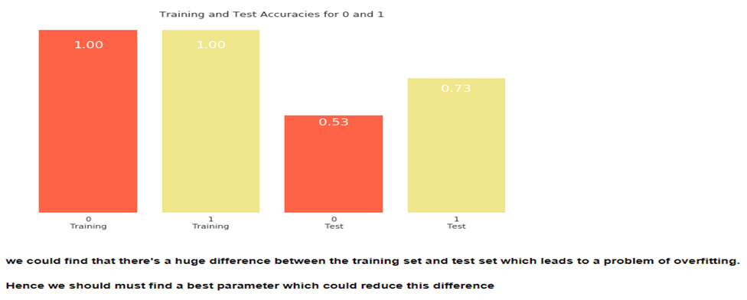
Decision Tree: training and testing accuracies by target value

Slide 41
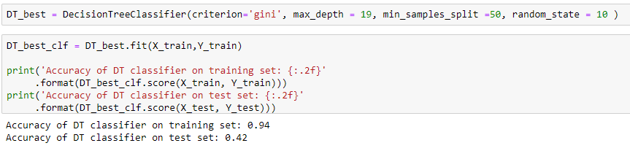
Decision Tree : Change of Parameter

Slide 42
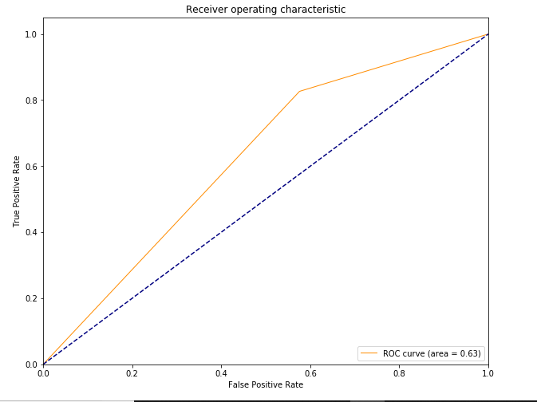
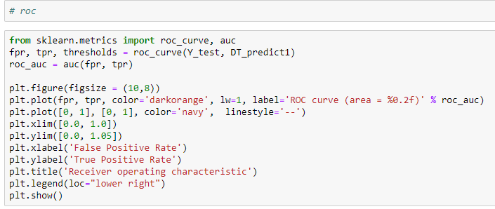
Decision Tree: New ROC = 0.63

Slide 43
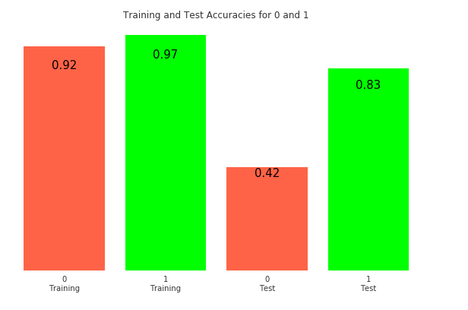
Decision Tree: training and testing accuracies by target value
Recall is improved

Slide 44
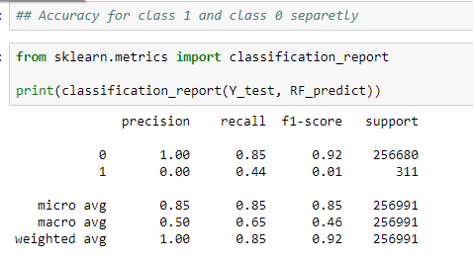
Random Forest : Accuracy

Slide 45
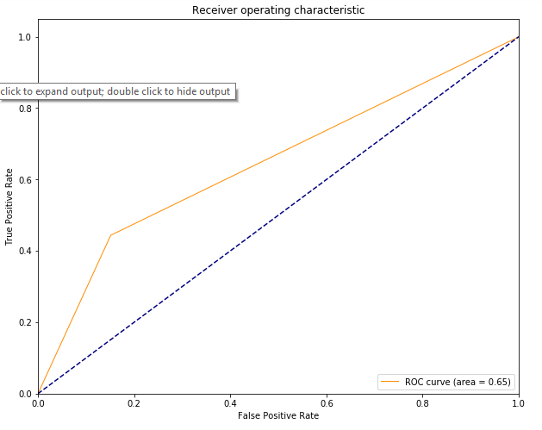
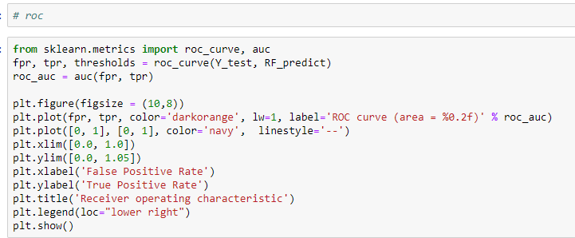
Random Forest : Roc = 0.65

Slide 46
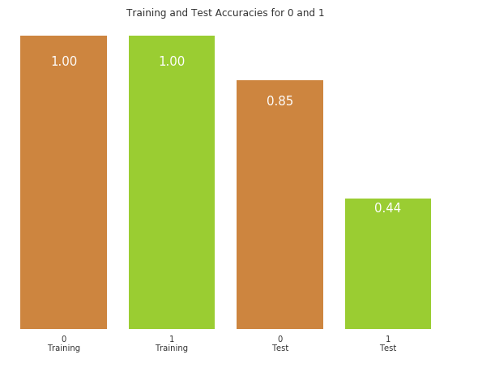
Random Forest : the training and testing accuracies by target value
Not a better measure for our problem.

Slide 47
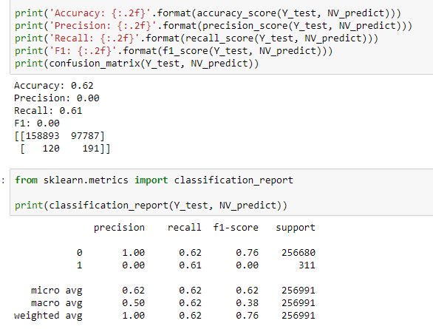
Naive Bayes : Accuracy

Slide 48
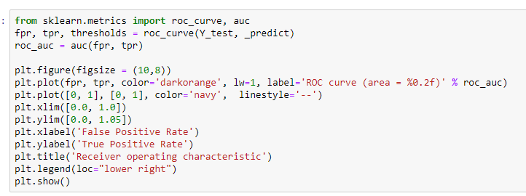
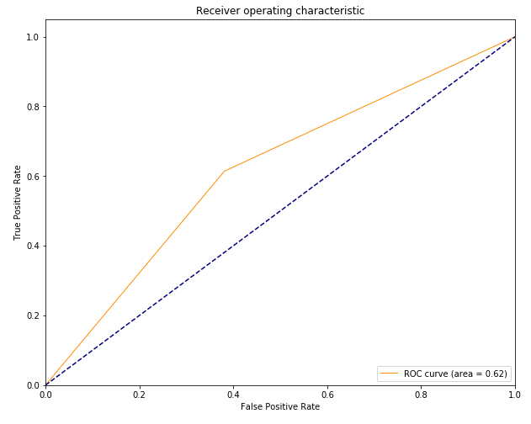
Naive Bayes : Roc = 0.62

Slide 49

Naive Bayes : training and testing accuracies by target value
Still no better result

Slide 50

Gradient Boosting Classification : Accuracy

Slide 51


XGBOOST Classification : ROC = 0.65

Slide 52

XGBOOST CLF: training and testing accuracies by target value
Best results until now though situation of under fitting.

